Slide 1
THE DATA JOURNEY Ernst & Young Carbon Prediction Hackathon Presented by: Maina Julius
Julius, an avid student of machine learning and AI, is passionate about furthering his knowledge and expertise in these fields.

Slide 2
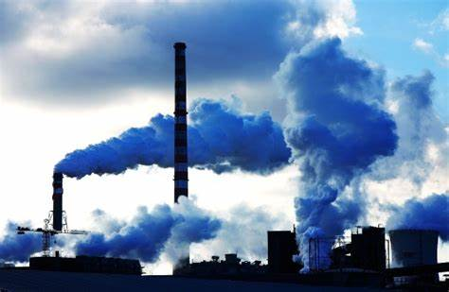
1. Introduction
Monitoring carbon emissions is vital to combat climate change. Accurate measurements help researchers and governments understand the sources and patterns of carbon output.
I used a machine learning model using open-source CO2 emissions data (from Sentinel-5P satellite observations provided) to predict carbon emissions.
While Europe and North America have robust monitoring systems, Africa has limited infrastructure in place. This calls for the development and expansion of carbon monitoring systems in Africa to ensure comprehensive data collection.

Slide 3

2. Background
My performance in this challenge really benefited from studying other related or similar competitions hosted by Zindi in the past.
One of such related competitions was Layer.ai Air Quality Prediction Challenge. The insights from the top team went a long way to say the least. Also, the notebook solution made public by the fourth best competitor (Sodiq_ from Nigeria) helped a lot.
The other competition was exactly like this one! UmojaHack Africa 2023: Carbon Dioxide Prediction Challenge (BEGINNER). The top competitor (Koleshjr from Kenya) shared his work that topped the competition with RMSE of 7202 on the private leaderboard. That work is a master piece!
I first tried new approaches but with little progress. So I resorted to tweaking the previous works’ features here and then there.. Trying different approaches of achieving similar results..the results? Best submission had RMSE of 5959 on private leaderboard!

Slide 4

3. Data Cleaning
This is the process of identifying and correcting or removing errors, inconsistencies, and inaccuracies in datasets.
Cleaning data give better Improved Data Quality and hence can help achieve Improved Model Performance,

Slide 5
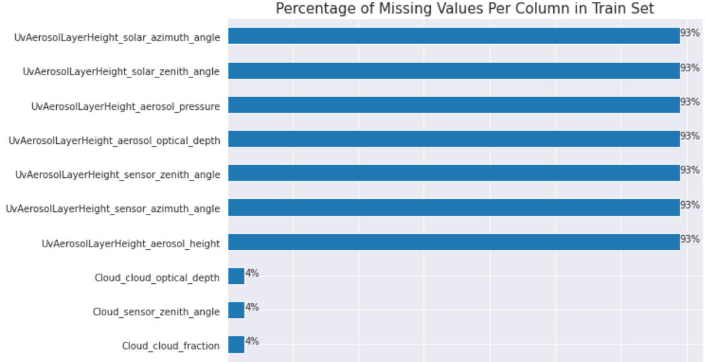
Data Cleaning Continued..
Columns with greater than 90% values missing were dropped
Other data cleaning options such as filling missing values, removing outliers etc. degraded model performance.

Slide 6

4. Exploratory Data Analysis (EDA)
Data visualization and feature selection techniques are used to identify significant variables and relationships within data.
This process helps uncover patterns, trends, and correlations, providing insights into factors influencing CPI fluctuations.

Slide 7
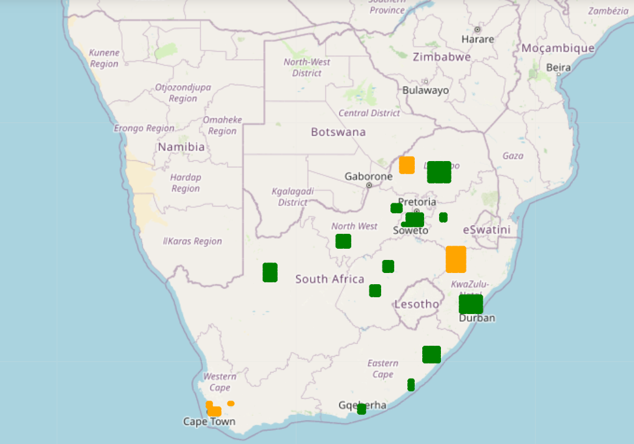
Location
The challenge described that the distribution of train dataset was different from that of test dataset to ensure good generalizability of results.
This is clearly shown in the map that shows the train locations in green and test locations in orange

Slide 8
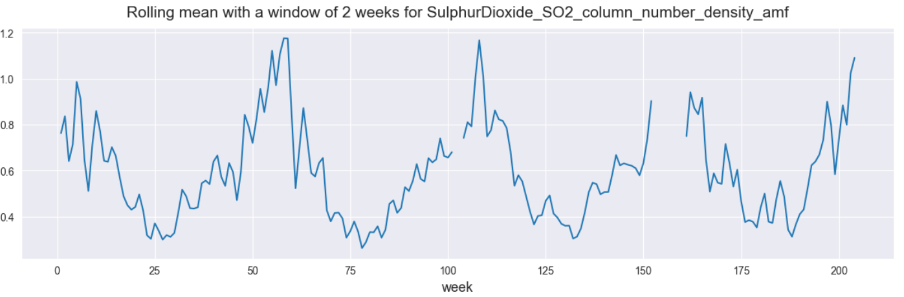
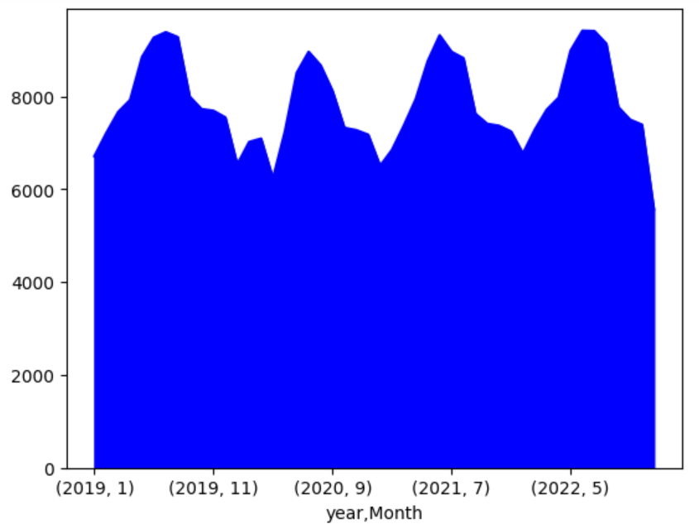
Cyclical Patterns
Upon scrutiny of the data, it was eminent that this was a time series data. This data when plotted by week depicted cyclical patterns.
Created a month feature and tried to check the cyclical patterns. Sure enough, the patterns were also present when year and month were used.
The analysis of the captured sensor data revealed a compelling correlation with time, thereby confirming the hypothesis that the data exhibits a time series pattern.

Slide 9
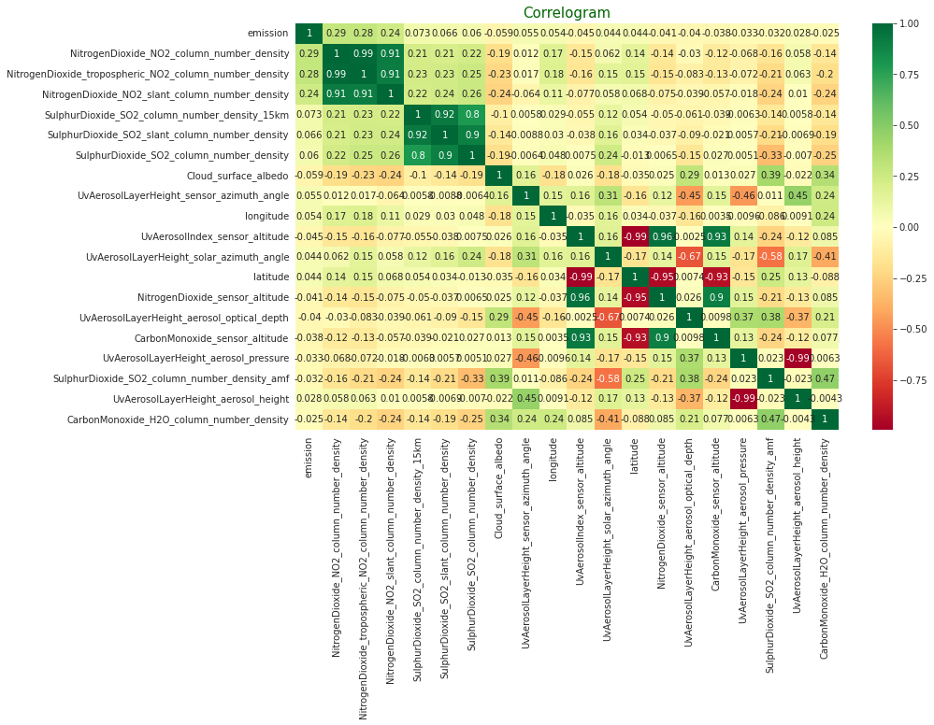
Correlation
The following columns had very low correlation with emissions.
-angle,
-altitude,
-depth and
-height

Slide 10
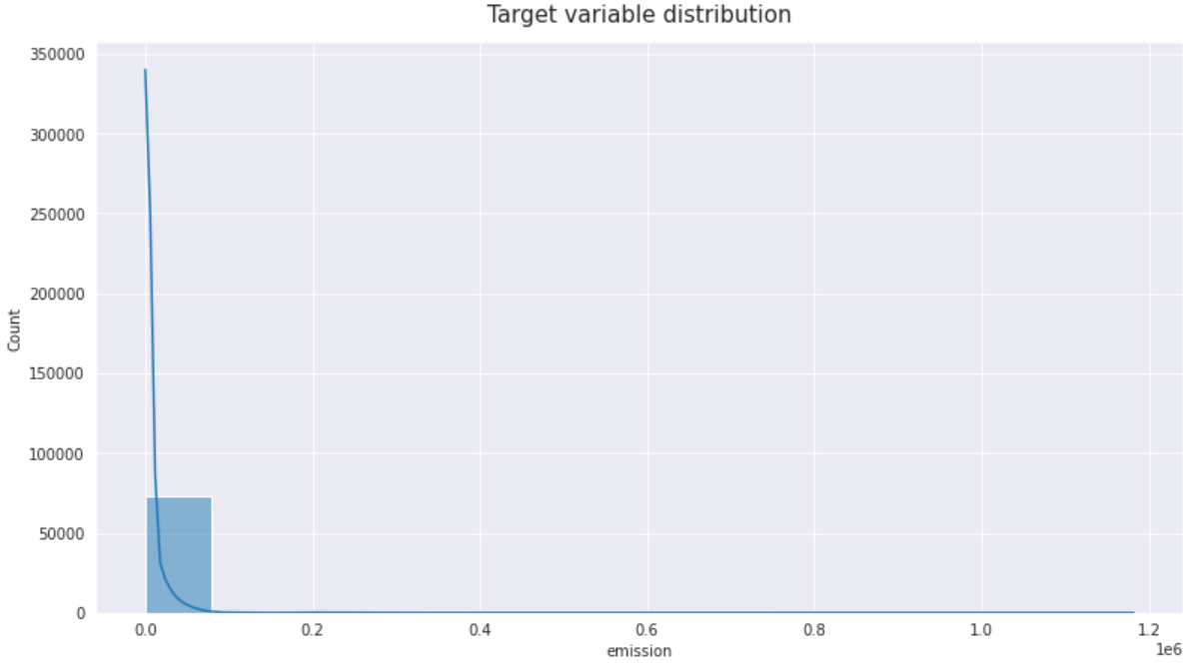
Distribution of Target Variable
The target variable was skewed to the right with a degree of -17.This means that the majority of the data points have lower values, while a few data points have extremely high values.
This can lead to Biased Predictions, poor model performance if model assumes normal distribution, make Evaluation Metrics such as mean not representative and also affect the assessment of feature importance.

Slide 11

4. Feature Engineering
Refers to the process of creating new features or transforming existing features in a dataset to improve the performance of machine learning models.
This led to Improved Model Performance & Enhanced Data Representation

Slide 12
Feature Engineering Contd..
Combined both train and test into one huge dataset for easy manipulation and to have a time series data.
Created a new feature location based on longitude and latitude columns and then dropped the longitudes and the latitudes column.
Created a new feature month
Dropped all columns that had angle, altitude, height or depth in them. These had very low correlation with target variable.
Created periodic trigonometric features –sine and cosine. A sine and cosine transformation reshapes data to capture cyclic patterns in our time series
Created periodic spline based features to capture the cycles seen in the data. spline interpolation was very crucial to good results
Created rolling mean , max and min for periods, 25,50,75 and 100 in line with patterns seen in weekly emissions.
Created location based statistics - mean, max, min

Slide 13

5. Model Development
A 12 fold (stratified based on Month), Light Gradient Boosting Machine was used. LGBM is a gradient boosting framework that uses tree-based learning algorithms.
A default catboost was also used.

Slide 14

4. Further Preprocessing
Log transformation of target variable emission was done before predicting using the LGBM.
The predictions-log transformed values- had to be transformed back from log transformed values to their normal distribution

Slide 15

Model Evaluation
An ensemble of the two model predictions was used as the final submission. For catboost -60% of weight and LGBM 40 % of weights was done.
The results were good. Public leaderboard RMSE at 6244.150624, private at 5959.276500

Slide 16
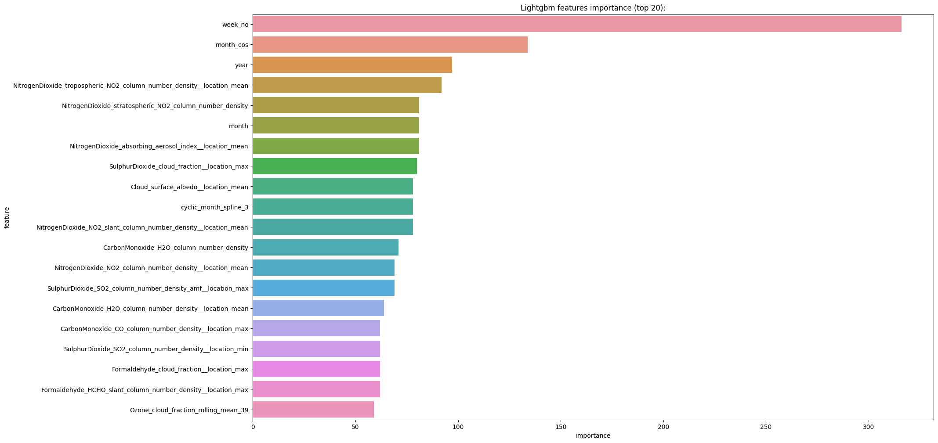
Most Important Features for Prediction Based on LGBM

Slide 17
Thank you for your time 😎

